Slide 1
Feed Need Workbook
FEED
Gene M. Pesti
Poultry Hub Australia
The University of New England

Slide 2
This workbook is based on breeder management guide feed consumption for birds kept at normal or average temperatures.
If your birds are cooler than the reference, they will tend to eat more and grow faster.
If your birds are warmer than the reference, they will tend to eat less and be more efficient.

Slide 3
FEED NEEDS
THIS WORKBOOK TAKES STANDARD OR REFERENCE FEED CONSUMPTION DATA AND USES IT TO PREDICT CONSUMPTION DURING A SPECIFIED INTERVAL
BREEDING COMPANIES ARE GOOD SOURCES OF DATA, BUT RESULTS FROM YOUR OWN FARM ARE PROBABLY THE BEST TO USE
Notes:
I think this is the great challenge for the young nutritionists today, to come up with a practical replacement for the least-cost feed formulation model that has been very good for poultry nutritionists, at least up until now.

Slide 4
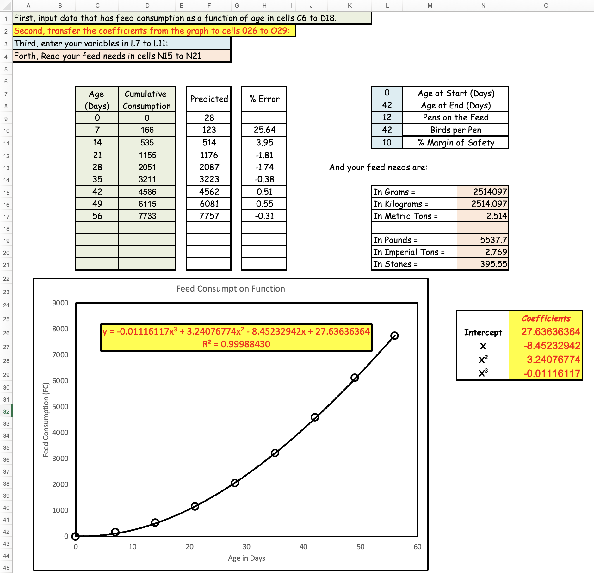
TRANSFER CONSUMPTION DATA TO THE INPUT OUTPUT SPREADSHEET

Slide 5
THE BEST-FIT EQUATION COEFFICIENTS IN THE GRAPH SHOULD UPDATE. IF THEY DON’T,
DELETE THE COEFFICIENTS IN THE GRAPH
RIGHT CLICK ON THE LINE
CHOOSE “FORMAT TRENDLINE”
CHECK THE BOX FOR “DISPLAY EQUATION ON CHART”
THE EQUATION SHOULD APPEAR

Slide 6
TRANSFER THE COEFFICIENTS FROM THE GRAPH TO CELLS O26 - 029

Slide 7
NEXT JUST INPUT THE SPECIFICS FOR THE PLANNED FEEDING IN CELLS L7 – L11
AND THE EXPECTED CONSUMPTION WILL APPEAR IN CELLS N15 –N21

Slide 8
THE CUBIC LINE IS A GOOD FIT FOR THE ENTIRE LIFE OF BROILERS
HOWEVER, THE ERROR MAY STILL BE HIGH DURING THE FIRST TWO WEEKS
THE ABSOLUTE AMOUNTS ARE NOT GREAT AND WON’T MATTER MUCH FOR A LONG TERM STUDY.

Slide 9
YOU MAY INCREASE THE ACCURACY OF THE PREDICTION BY CHOOSING DATA FROM A SEGMENT OF THE GROWTH CURVE
THIS VERSION 3.0.22 IS SET UP FOR A MAXIMUM OF 13 POINTS

