Slide 1
ITSEPG
Inverse Transformation Scale
Experimental Power Graphing
USER GUIDE
Prepared by:
Dr. Ricaro V. Nunes, Universidade Estadual do Oeste do Parana
Dr. Gene M. Pesti, University of Georgia
Version 1.0

Slide 2
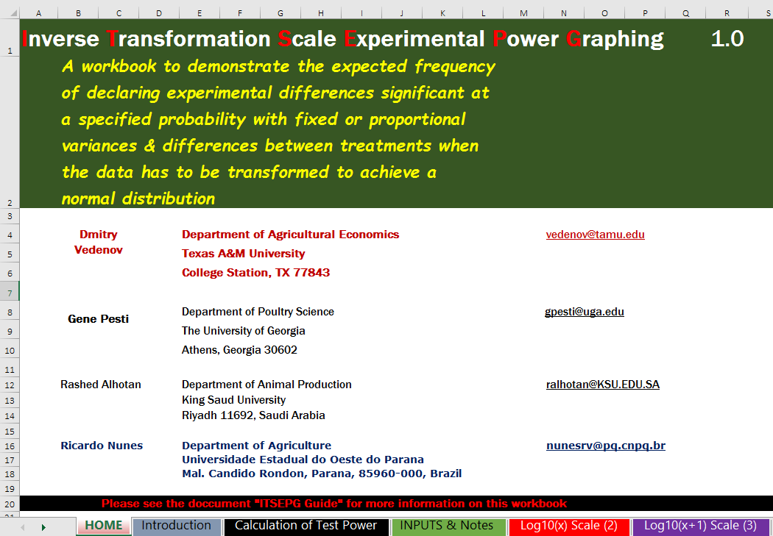

Slide 3
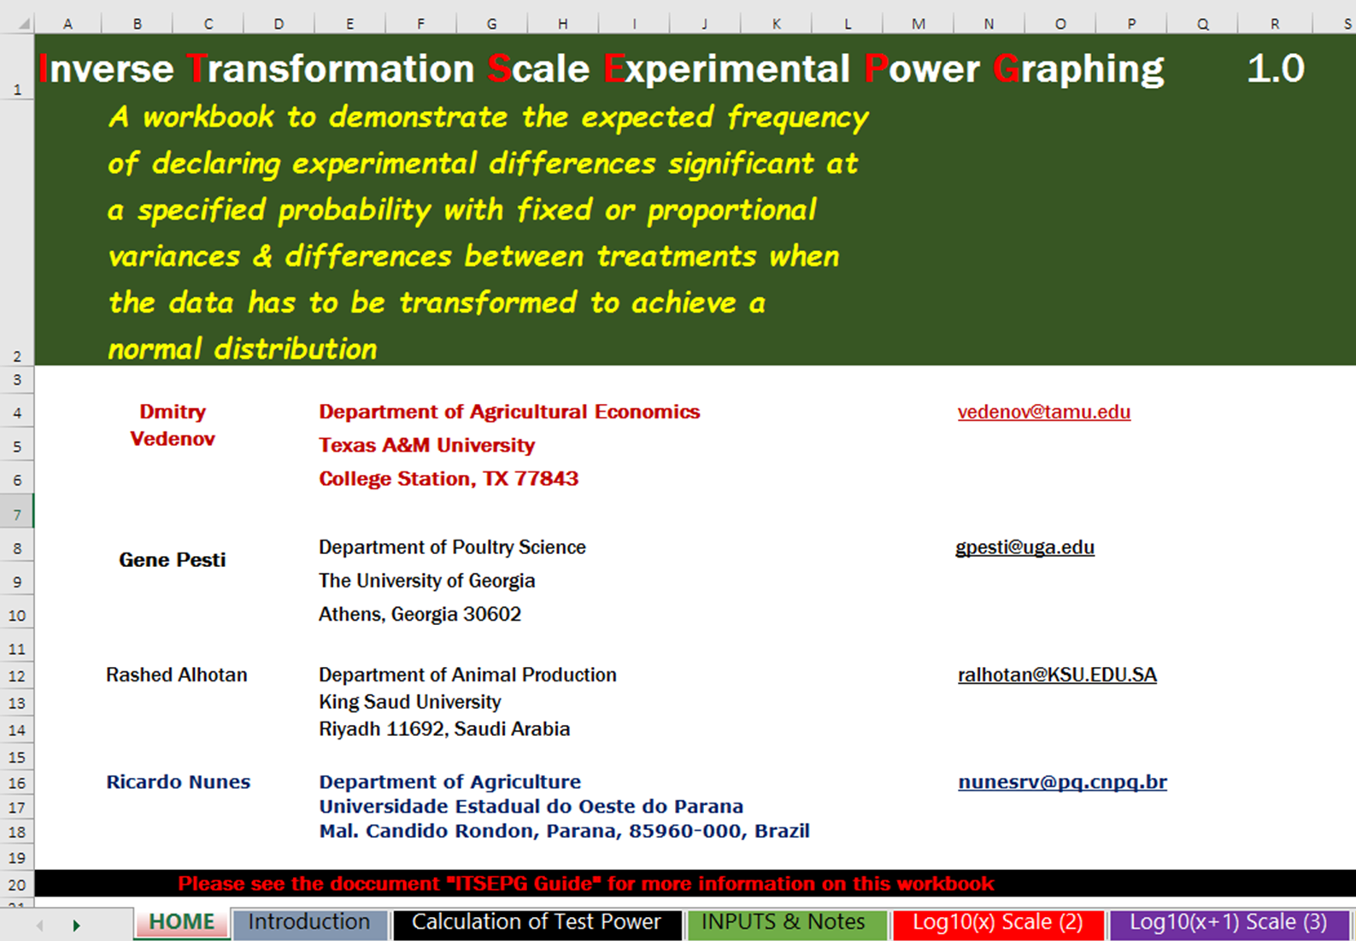
^{❶}Spreadsheet
Home
^{❺}Spreadsheets EP Data Inverse Transformation
^{❸}Spreadsheet
Calculation of Test Power
^{❹}Spreadsheet Inputs & Notes
^{❷}Spreadsheet Introduction

Slide 4
Introduction
Determining experimental power for planning purposes is, by its very nature, a risky business. Experiments are planned because we don't know what the results will be! We hope that the means and variances of control and treated groups will be similar to previous experiments, but that can't be assumed.
There is always the possibility that any imposed treatments will affect individuals differently, changing the variation between treatment groups. Sometimes the data is not "normally" distributed, e.g., frequency distributions do not resemble bell shaped curves.
To properly analyze non-normal data, some transformation is needed to make it appear normal. QQ Plots may be helpful to see if a given transformation will make the data more "normal" and improve the accuracy of probability estimates using analyses of variance.

Slide 5
Introduction
Whenever non-normal data is transformed to make it normal for analyses of variance, the scales are changed and it becomes difficult to visualize how differences in the original data relate to differences in the transformed data. The example below is for Blood Uric Acid levels in chickens.
The QQ Plot R² is improved from 0.91 to 0.99 by taking the log₁₀ of the original data. When the log of the individual data (Minimum or Maximum for instance) is taken and 10 is raised to that power (the inverse transformation), the result is exactly the same as the starting value.
However, this is not true for the mean or other descriptive statistics. Not only are the mean and inverse transformed mean different, but the lower and upper 90 % confidence limits for the inverse transformed mean are no longer equally distant from the mean. (See Table below)
Descriptive statistics for the blood uric acid of 210 broiler chickens (X)
Variable | Minimum | Maximum | Std Error | Std Deviation | Lower 90% CL for Mean | Interval | Mean | Interval | Upper 90% CL for Mean
X | 1.711 | 9.374 | 0.092 | 1.327 | 3.550 | 0.151 | 3.701 | 0.151 | 3.852
log₁₀X=T | 0.233 | 0.972 | 0.010 | 0.145 | 0.527 | 0.017 | 0.543 | 0.017 | 0.560
10^{T} | 1.711 | 9.374 | 1.023 | 1.397 | 3.364 | 0.131 | 3.495 | 0.136 | 3.631

Slide 6
Introduction
How then to relate differences in the transformed results to differences in the original data? With changes in the transformed data are direct linear functions of the changes in the original data (tables and figures below).
With the log₁₀ transformation, a 1% difference in the original data corresponds to approximately a 1.6% difference in the transformed data, etc. If the sin of the data has to be taken to make them normal, a 1% difference in the original data results in about a 1.074% change when the data are inverse transformed back to the original scale. Since the scales are related linearly, predicting the number of replicates to find a given difference should be possible by the methods used here. Note that the linear relationship is not a perfect correlation, there is an intercept.
Nonetheless, it is always important to remember that the descriptive statistics for the transformed data cannot be directly converted to the original scale.
For example, the standard deviation for the transformed data cannot just be transformed to the original scale. It would be more appropriate to determine the lower and upper confidence limits in the transformed data and invert those to the original scale.

Slide 7
Difference between original data vs transformation data
% Difference | X | log₁₀(X) | 10^{(log10(X))} |  | Δ X | Δ 10^{(log10(X))}
 | 3.701 | 0.568 | 3.701 |  | 0 | 0.000
0 | 3.701 | 0.568 | 3.701 |  | 5 | 6.762
5 | 3.886 | 0.597 | 3.951 |  | 10 | 13.981
10 | 4.071 | 0.625 | 4.218 |  | 15 | 21.687
15 | 4.256 | 0.654 | 4.504 |  | 20 | 29.916
20 | 4.441 | 0.682 | 4.808 |  | 25 | 38.700
25 | 4.626 | 0.710 | 5.133 |  | 30 | 48.078
30 | 4.811 | 0.739 | 5.480
Log₁₀
% Difference | X | sin(X) | asin(sin(X)) |  | Δ X | Δ asin(sin(X))
 | 3.701 | 0.358 | 3.662 |  | 0 | 0.000
0 | 3.701 | 0.358 | 3.662 |  | 5 | 5.256
5 | 3.886 | 0.376 | 3.855 |  | 10 | 10.553
10 | 4.071 | 0.394 | 4.049 |  | 15 | 15.895
15 | 4.256 | 0.412 | 4.244 |  | 20 | 21.284
20 | 4.441 | 0.430 | 4.442 |  | 25 | 26.725
25 | 4.626 | 0.448 | 4.641 |  | 30 | 32.220
30 | 4.811 | 0.466 | 4.842
Sin(x)

Slide 8
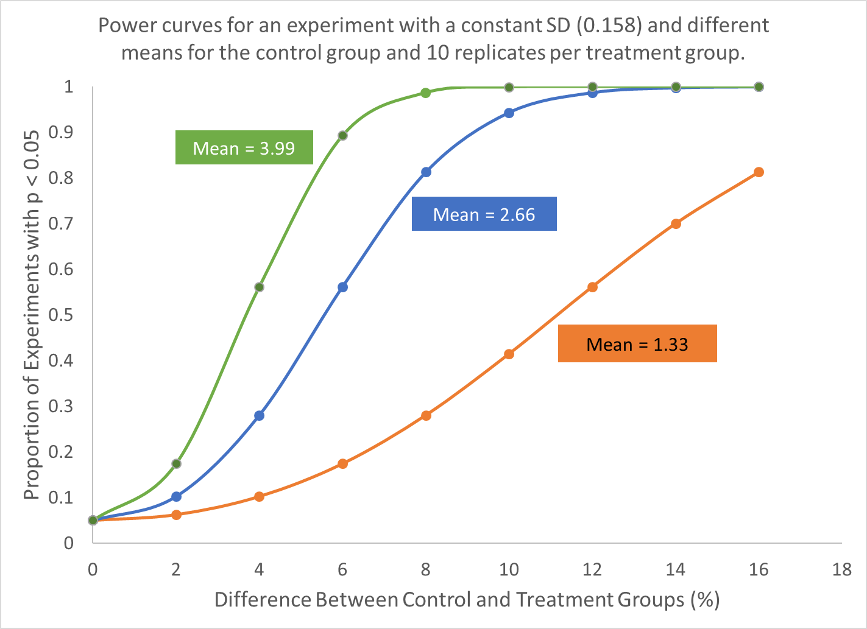
Introduction
When estimating experimental power, it is important to know the variation expected in the results. It is just as important to know the mean of the control or normal reference group. The example in the graph below shows how important it is to know both the mean and standard error when estimating experimental power.
For planning purposes, it may be best to use the expected mean of the control or reference group. Then the estimated power will be for differences from that mean.

Slide 9
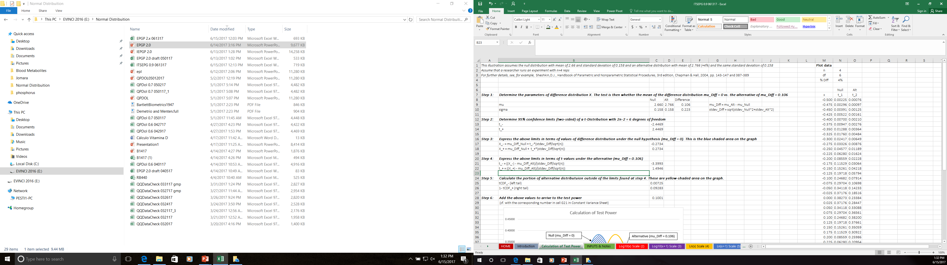
STEP 1 - Calculation of Test Power – For example
Null distribution, mean of 2.66
Alternative distribution, mean of 2.766 (+4%)
SD of 0.158
Same ST of 0.158
Reps = 4

Slide 10
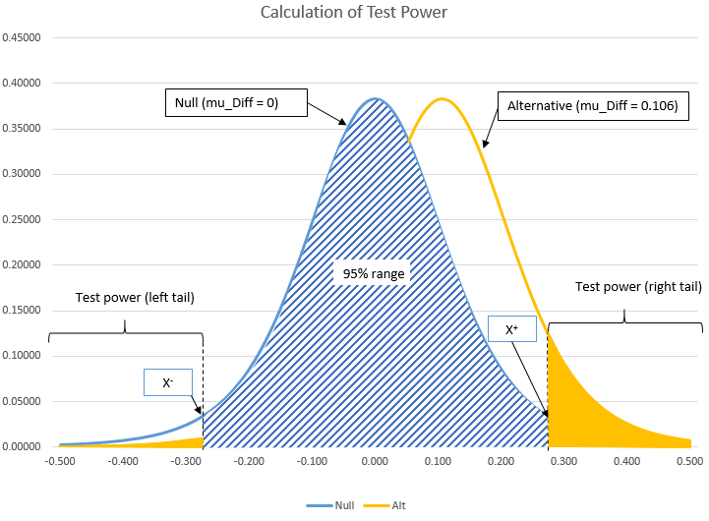
STEP 1 - Calculation of Test Power – For example
Better Experimental Power
The results are different at 5%

Slide 11
STEP 2 - NOTES
^{❶} The two graphs included on each spreadsheet display the power of a t-test based on two samples of size n Reps each when trying to separate two distributions with given means and variances (null and alternative)
^{❷} Both graphs allow the choice of % difference in means of the null and alternative distributions and baseline (null) standard deviation.
^{❸} The standard deviation of the alternative distribution is then calculated either based on constant CV (Constant CV table) or is set equal to that of null distribution (Constant Variance table)
^{❹} The calculation of test power consists of determining the area under the probability density function of the alternative distribution outside of the bounds determining the 95% confidence interval of the null distribution (see explanation and figure)

Slide 12
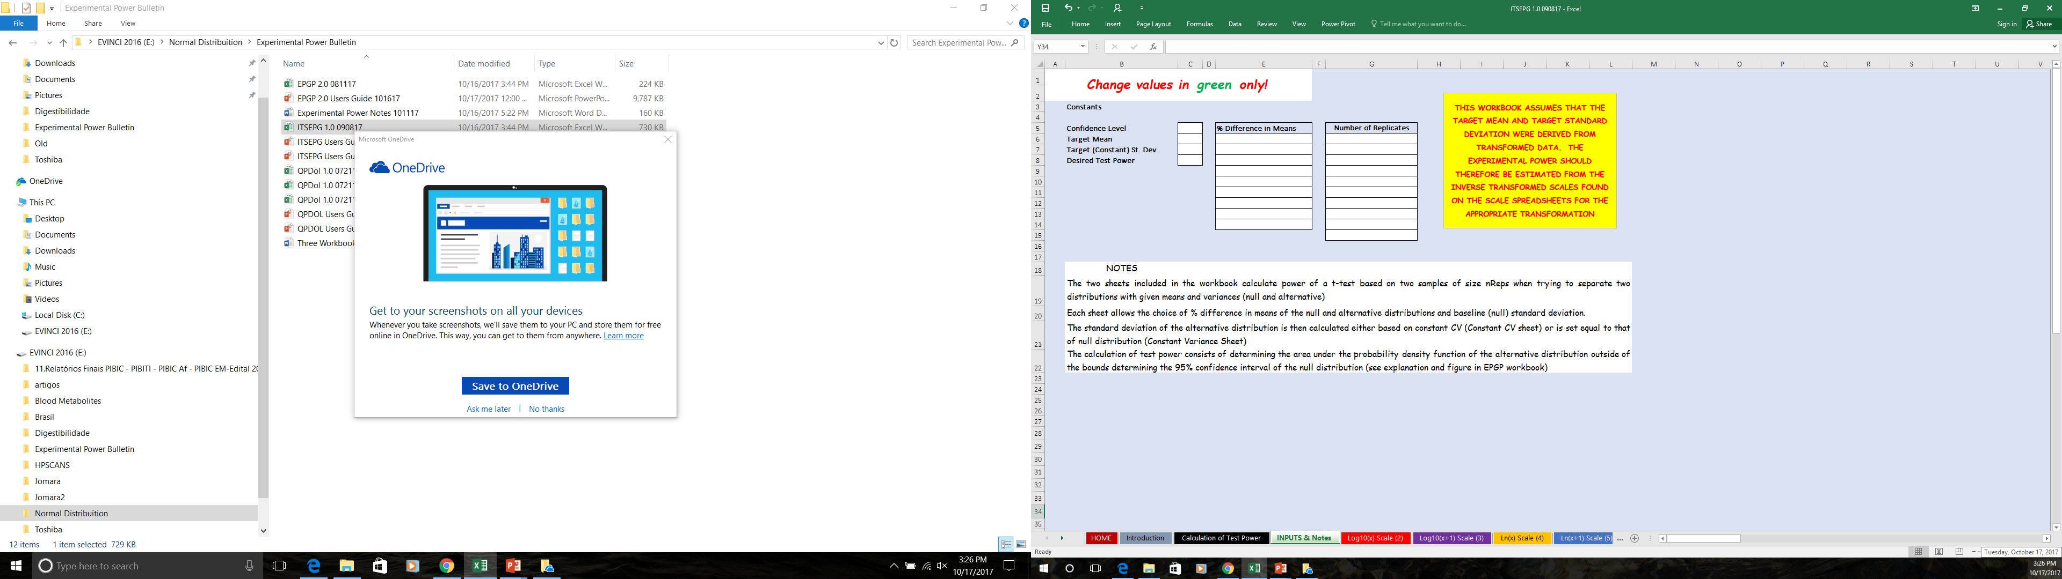
STEP 3 - Working with ITSEPG - Input data
^{❶}Open the program and after reading information
Click on the worksheet

Slide 13
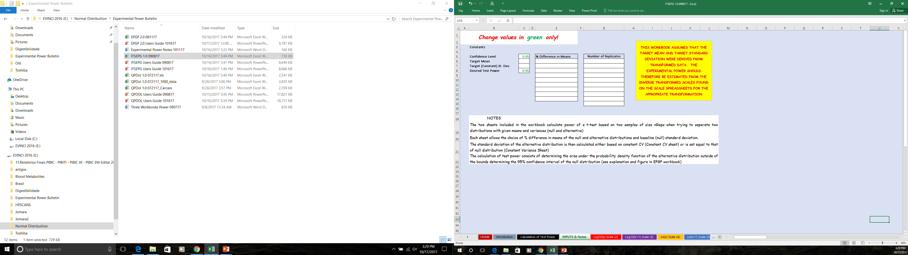
STEP 3 - Working with ITSEPG - Input data
Enter - Desired Test Power and Confidence Level
Confidence Level + Test Power = 1.00
These may vary:
0.01 – 0.99
0.05 – 0.95
0.10 – 0.90
“Depends on the rigor that the user wants”

Slide 14
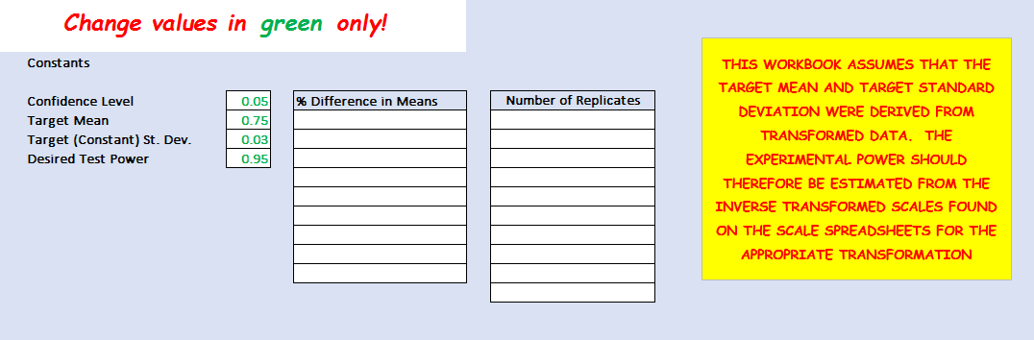
STEP 3 - Working with ITSEPG - Input data
Enter – Mean and St. Deviation
Data from your experiment

Slide 15

STEP 3 - Working with ITSEPG - Input data
Enter – % Difference in Means

Slide 16

STEP 3 - Working with ITSEPG - Input data
Enter – Numbers Replicates
Again - Change values in green, only
IMPORTANT
Other changes occur automatically

Slide 17
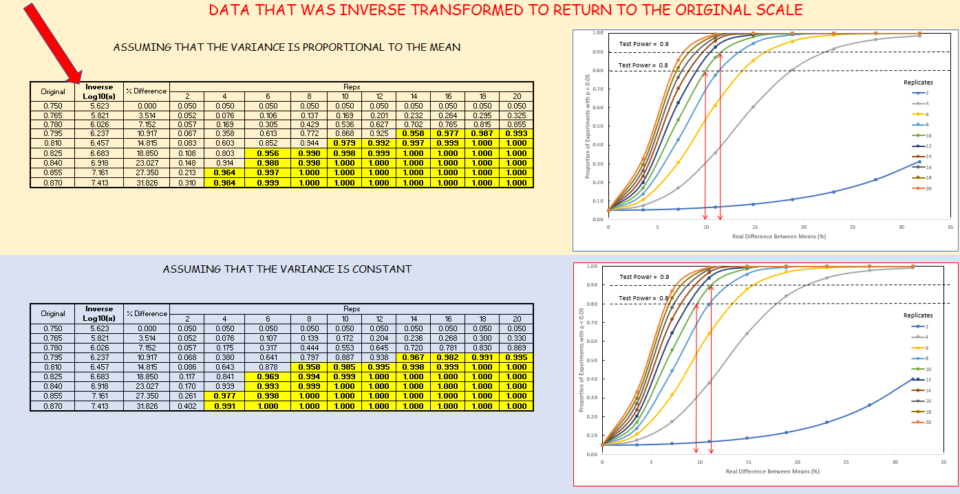
STEP 4 - Results
Results: data was inverse transformed to return to the original scale before graphing
For example, with:
Confidence level: 0.05 and Desired test power: 0.95
- Have the following:
Example – Log_{10(x)}
To 10 replicates the difference between mean, can be
Constant CV
- Test Power 0.8: Below 10%
- Test Power 0.9: Above 10%
Constant Variance

Slide 18
STEP 4 - Results
Results: data was inverse transformed to return to the original scale before graphing
Constant CV
To Constant CV is necessary 10 replicates to found difference between average (TP: 0.9)
To Constant Variance is necessary 8 replicates to found difference between average (TP: 0.9)
Constant Variance

Slide 19
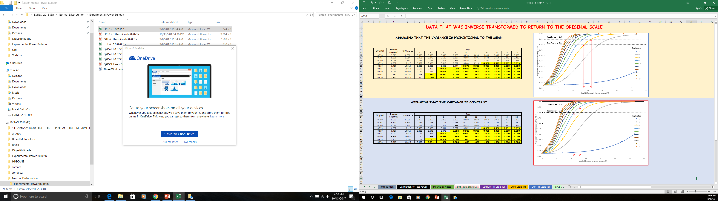
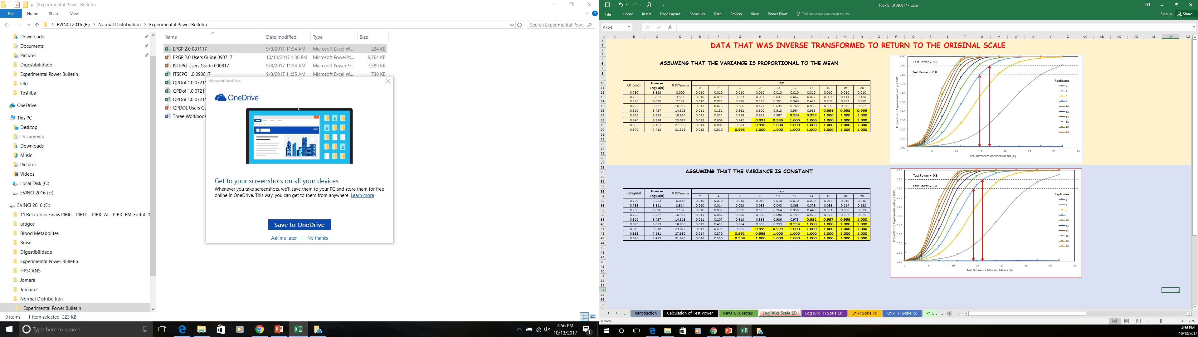
Results – Constant CV
When the Test Power is 0.95 and the Confidence Level 0.05, we found that
Confidence Level: 0.05
Target Mean: 0.75
Target SD: 0.03
Desired Test Power: 0.95
6 replicates we have 18.85% of difference between means
10 replicates we have 14.815% of difference between means
Confidence Level: 0.01
Target Mean: 0.75
Target SD: 0.03
Desired Test Power: 0.99
When the Test Power is 0.99 and the Confidence Level 0.01, we found that
6 replicates we have 31.826% of difference between means
8 replicates we have 23.027% of difference between means

Slide 20
Results – Constant Variance
When the Test Power is 0.95 and the Confidence Level 0.05, we found that
Confidence Level: 0.05
Target Mean: 0.75
Target SD: 0.03
Desired Test Power: 0.95
6 replicates we have 18.85% of difference between means
10 replicates we have 14.815% of difference between means
Confidence Level: 0.01
Target Mean: 0.75
Target SD: 0.03
Desired Test Power: 0.99
When the Test Power is 0.99 and the Confidence Level 0.01, we found that
6 replicates we have 27.35% of difference between means
10 replicates we have 14.815% of difference between means

Slide 21
Important points
^{❶} This ITSEPG workbook was designed for data needing a transformation and inverse transformation for estimating experimental power. The QPDOL.exe workbook may be helpful to determine if a transformation is needed to help normalize data for analysis, and if so, ITSEPG should be helpful for graphing the inverse transformed data.
^{❷} A basic assumption of Analysis of Variance is that variances are equal. While it may not be possible to prove variances are not equal, it is sometimes obvious that variation increases proportional to the mean. For instance, as birds grow, they become more variable. Therefore calculations in ITSEPG are produced for both constant absolute variation and constant coefficient of variation models.
^{❸} ITSEPG.xls is a planning tool. While it may be intuitive that having more replication improves the chances of finding statistically significant differences, in reality the determined p-value “is what it is.” Planning an experiment with a large number of replicates should not influence the determined p-value and should not be interpreted as doing so.

