Slide 1
Maximizing research results by using simulation in nutritional requirement study planning
Dmitry Vedenov¹, Gene Pesti^{2*} & Rashed Alhotan²
¹Department of Agricultural Economics
Texas A&M University
²Department of Poultry Science;
University of Georgia

Slide 2
Introduction
Nutritional Requirements:
The lowest level of a nutrient resulting in maximal performance
Experimentally determined with pens of birds
The most common statistical tool used to determine the requirement is a multiple range test.
Experimental design usually based on tradition and cost

Slide 3
Question:
What is the optimal distribution of resources between nutrient levels and replicates per level for determining nutritional requirements?
- Resources refers to pen size and numbers
Answer:
An Excel workbook capable of simulating nutritional requirement experiments:
- Nutritional Response Determination Optimization

Slide 4
Introduction

Slide 5
Assumptions
Rough estimate of requirement
Knowledge of CV of pen means in your house
Known response shape
Broken-Line Linear Model?
Broken-Line Quadratic Model?
Saturation Kinetics Model?
Quadratic Polynomial?

Slide 6
Quadratic Polynomial Model (QP)

Slide 7
Broken Line Linear Model (BLL)

Slide 8
Broken Quadratic Model (BLQ)

Slide 9
Saturation Kinetics Model (SK)

Slide 10
Materials and Methods

Slide 11
Materials and Methods

Slide 12
Materials and Methods

Slide 14
Simulation Using NuRDO
“Simulations” Tab

Slide 15
Simulation Using NuRDO
“Levels & Reps” Tab

Slide 16
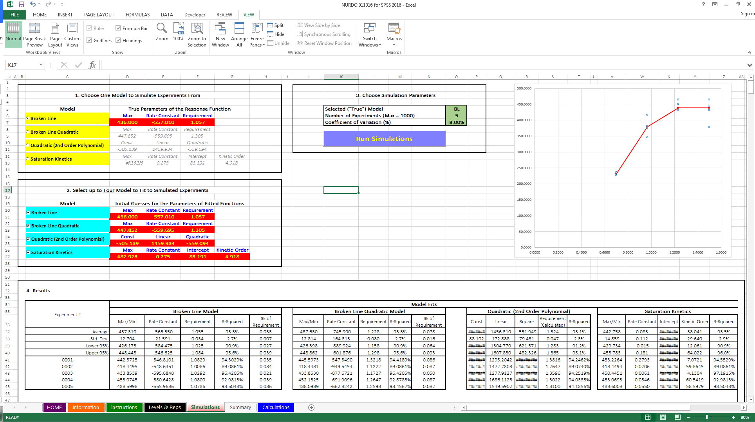
Simulation Using NuRDO
“Simulations” Tab

Slide 17
Simulation Using NuRDO
“Simulations” Tab

Slide 18
Simulation Using NuRDO
“Simulations” Tab

Slide 19
Simulation Using NuRDO
“Simulations” Tab

Slide 20
Results

Slide 21
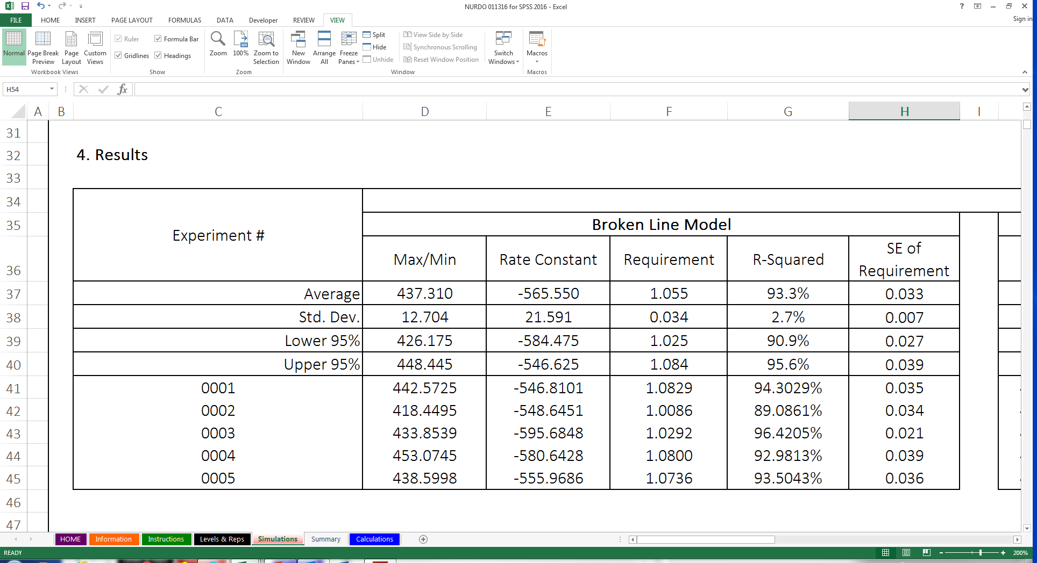
Simulation Using NuRDO
“Simulations” Tab

Slide 22
Simulations of lysine requirements based on BLL model, 100 simulations, 8% CV & a Lys range of 0.7– 1.5%
ACTUAL REQUIREMENT = 1.057 %
Pens | Levels | Reps | BLL Model |  |  | BLQ Model |  |  | QP Model | SK Model
 |  |  | Req. | ± SE | R² | Req. | ± SE | R² | R² | R²
 |  |  | …………………………%..............................
16 | 4 | 4 | 1.050 | 0.041 | 89.5 | 1.216 | 0.022 | 89.5 | 89.1 | 89.7
24 | 6 | 4 | 1.064 | 0.038 | 87.1 | 1.245 | 0.017 | 86.3 | 85.9 | 87.4
24 | 4 | 6 | 1.053 | 0.034 | 88.9 | 1.231 | 0.018 | 89.0 | 88.3 | 89.2
24 | 8 | 3 | 1.058 | 0.040 | 85.3 | 1.237 | 0.023 | 84.5 | 84.2 | 85.1
48 | 8 | 6 | 1.057 | 0.027 | 85.4 | 1.222 | 0.007 | 84.4 | 83.8 | 84.8
48 | 6 | 8 | 1.060 | 0.025 | 86.7 | 1.238 | 0.008 | 86.0 | 85.6 | 86.9
96 | 8 | 12 | 1.058 | 0.019 | 84.3 | 1.227 | 0.004 | 83.4 | 82.8 | 83.9
BLL = Broken-Line Linear Model QP = Quadratic Polynomial
BLQ = Broken-Line Quadratic Model SK = Saturation Kinetics Model

Slide 23
Simulations of lysine requirements based on BLL model, 100 simulations, 8% CV & a Lys range of 0.9– 1.3%
ACTUAL REQUIREMENT = 1.057 %
Pens | Levels | Reps | BLL Model |  |  | BLQ Model |  |  | QP Model | SK Model
 |  |  | Req. | ± SE | R² | Req. | ± SE | R² | R² | R²
 |  |  | …………………………%..............................
16 | 4 | 4 | 1.071 | NA | 61.2 | 1.252 | NA | 61.4 | 61.1 | 61.8
24 | 6 | 4 | 1.064 | 0.046 | 56.0 | 1.204 | 4.742 | 55.3 | 54.7 | 56.7
24 | 4 | 6 | 1.061 | 0.041 | 58.5 | 1.171 | 6.322 | 58.8 | 57.8 | 59.0
24 | 8 | 3 | 1.058 | 0.044 | 51.6 | 1.218 | 27.177 | 50.8 | 49.6 | 53.3
48 | 8 | 6 | 1.061 | 0.032 | 48.9 | 1.148 | 0.033 | 48.4 | 47.6 | 49.7
48 | 6 | 8 | 1.053 | 0.035 | 51.3 | 1.136 | 0.027 | 50.7 | 49.9 | 51.9
96 | 8 | 12 | 1.062 | 0.023 | 47.4 | 1.143 | 0.011 | 46.8 | 46.1 | 47.6
BLL = Broken-Line Linear Model QP = Quadratic Polynomial
BLQ = Broken-Line Quadratic Model SK = Saturation Kinetics Model

Slide 24
Simulations of lysine requirement based on BLL model, 8% CV & a Lys range of 0.7– 1.5%
ACTUAL REQUIREMENT = 1.057 %
Pens | Levels | Reps | Sims | BLL Model |  |  | BLQ Model |  |  | QP Model | SK Model
 |  |  |  | Req. | ± SE | R² | Req. | ± SE | R² | R² | R²
 |  |  |  | …………………………%..............................
24 | 8 | 3 | 5 | 1.049 | 0.037 | 86.6 | 1.190 | 0.014 | 84.7 | 84.4 | 84.9
24 | 8 | 3 | 10 | 1.036 | 0.043 | 84.2 | 1.207 | 0.015 | 83.1 | 82.5 | 84.4
24 | 8 | 3 | 20 | 1.070 | 0.040 | 85.9 | 1.240 | 0.020 | 85.5 | 85.3 | 85.7
24 | 8 | 3 | 50 | 1.064 | 0.038 | 86.4 | 1.253 | 0.020 | 85.6 | 85.5 | 86.4
24 | 8 | 3 | 100 | 1.054 | 0.040 | 85.6 | 1.230 | 0.025 | 84.7 | 84.1 | 85.4
24 | 8 | 3 | 1000 | 1.058 | 0.039 | 85.9 | 1.236 | 0.019 | 84.9 | 84.5 | 85.8
BLL = Broken-Line Linear Model QP = Quadratic Polynomial
BLQ = Broken-Line Quadratic Model SK = Saturation Kinetics Model
Sims = Number of simulations

Slide 25
Simulations of lysine requirements based on BLL model, 100 simulations & a Lys range of 0.7– 1.5%
ACTUAL REQUIREMENT = 1.057 %
Pens | Levels | Reps | CV (%) | BLL Model |  |  | BLQ Model |  |  | QP Model | SK Model
 |  |  |  | Req. | ± SE | R² | Req. | ± SE | R² | R² | R²
 |  |  |  | …………………………%..............................
24 | 8 | 3 | 2 | 1.057 | 0.008 | 99.0 | 1.225 | 0.003 | 98.0 | 97.3 | 98.4
24 | 8 | 3 | 4 | 1.056 | 0.018 | 96.1 | 1.225 | 0.007 | 95.1 | 94.5 | 95.6
24 | 8 | 3 | 6 | 1.065 | 0.029 | 91.1 | 1.242 | 0.012 | 90.1 | 89.4 | 90.7
24 | 8 | 3 | 8 | 1.060 | 0.038 | 86.0 | 1.252 | 0.021 | 85.2 | 85.0 | 86.1
24 | 8 | 3 | 10 | 1.057 | 0.047 | 81.5 | 1.239 | 0.032 | 80.5 | 79.9 | 81.6
24 | 8 | 3 | 12 | 1.064 | 0.059 | 72.7 | 1.323 | 0.249 | 71.9 | 72.1 | 73.0
BLL = Broken-Line Linear Model QP = Quadratic Polynomial
BLQ = Broken-Line Quadratic Model SK = Saturation Kinetics Model

Slide 26
Summary
Using more levels or replications
Reduces the SE of the requirement
Decreases the R²
A wide range of input levels helps the models converge
Decreases SE
Increases R²

Slide 27
Summary
As the CV increases,
The SE of the requirement increases
The R² decreases
Twenty simulated experiments seem adequate, but running 100 takes only a few minutes more and may give better estimates
The choices of range of levels to feed and number of levels vs. number of reps independent of the model chosen
NuRDO can help quantitate experimental power for determining nutritional requirements

Slide 28
Thank you

Slide 31
Simulations of lysine requirements based on SK model, 100 simulations, 8% CV & a Lys range of 0.7– 1.5%
ACTUAL REQUIREMENT = ? APPROACHES ASYMPTOTE
Pens | Levels | Reps | BLL Model |  |  | BLQ Model |  |  | QP Model | SK Model
 |  |  | Req. | ± SE | R² | Req. | ± SE | R² | R² | R²
 |  |  | …………………………%..............................
16 | 4 | 4 | 1.097 | 0.048 | 90.6 | 1.377 | 0.087 | 91.1 | 91.1 | 91.6
24 | 6 | 4 | 1.108 | 0.042 | 87.3 | 1.379 | 0.045 | 88.6 | 88.4 | 89.0
24 | 4 | 6 | 1.102 | 0.043 | 89.5 | 1.390 | 0.036 | 90.0 | 89.8 | 90.5
24 | 8 | 3 | 1.115 | 0.045 | 85.1 | 1.376 | 0.043 | 86.3 | 86.1 | 86.9
48 | 8 | 6 | 1.129 | 0.032 | 84.5 | 1.394 | 0.020 | 85.7 | 85.7 | 86.1
48 | 6 | 8 | 1.117 | 0.033 | 85.8 | 1.393 | 0.026 | 87.0 | 86.9 | 87.3
96 | 8 | 12 | 1.125 | 0.023 | 83.8 | 1.383 | 0.009 | 85.2 | 85.1 | 85.4
BLL = Broken-Line Linear Model QP = Quadratic Polynomial
BLQ = Broken-Line Quadratic Model SK = Saturation Kinetics Model

Slide 32
Simulations of lysine requirements based on BLQ model, 100 simulations, 8% CV & a Lys range of 0.7– 1.5%
ACTUAL REQUIREMENT = 1.305 %
Pens | Levels | Reps | BLL Model |  |  | BLQ Model |  |  | QP Model | SK Model
 |  |  | Req. | ± SE | R² | Req. | ± SE | R² | R² | R²
 |  |  | …………………………%..............................
16 | 4 | 4 | 1.077 | 0.048 | 89.5 | 1.279 | 0.025 | 89.5 | 89.5 | 89.9
24 | 6 | 4 | 1.102 | 0.044 | 86.3 | 1.320 | 0.026 | 86.6 | 86.5 | 86.8
24 | 4 | 6 | 1.081 | 0.039 | 88.9 | 1.297 | 0.021 | 89.0 | 88.8 | 89.3
24 | 8 | 3 | 1.094 | 0.045 | 84.0 | 1.321 | 0.044 | 84.8 | 84.8 | 84.9
48 | 8 | 6 | 1.097 | 0.031 | 84.1 | 1.303 | 0.011 | 84.7 | 84.5 | 84.7
48 | 6 | 8 | 1.100 | 0.030 | 85.8 | 1.313 | 0.011 | 86.3 | 86.1 | 86.4
96 | 8 | 12 | 1.100 | 0.023 | 82.9 | 1.308 | 0.006 | 83.6 | 83.5 | 83.6
BLL = Broken-Line Linear Model QP = Quadratic Polynomial
BLQ = Broken-Line Quadratic Model SK = Saturation Kinetics Model

Slide 33
Simulations of lysine requirements based on QP model, 100 simulations, 8% CV & a Lys range of 0.7– 1.5%
ACTUAL REQUIREMENT = ??
Pens | Levels | Reps | BLL Model |  |  | BLQ Model |  |  | QP Model | SK Model
 |  |  | Req. | ± SE | R² | Req. | ± SE | R² | R² | R²
 |  |  | …………………………%..............................
16 | 4 | 4 | 1.077 | 0.050 | 88.9 | 1.256 | 0.030 | 88.6 | 89.2 | 89.0
24 | 6 | 4 | 1.078 | 0.043 | 85.4 | 1.257 | 0.023 | 85.5 | 86.5 | 85.7
24 | 4 | 6 | 1.069 | 0.040 | 87.4 | 1.250 | 0.022 | 87.3 | 88.1 | 87.5
24 | 8 | 3 | 1.075 | 0.045 | 83.6 | 1.268 | 0.022 | 84.0 | 84.8 | 84.0
48 | 8 | 6 | 1.079 | 0.031 | 83.0 | 1.264 | 0.009 | 83.4 | 84.0 | 83.2
48 | 6 | 8 | 1.081 | 0.029 | 84.8 | 1.260 | 0.010 | 85.1 | 85.7 | 85.1
96 | 8 | 12 | 1.081 | 0.022 | 81.9 | 1.266 | 0.005 | 82.5 | 83.1 | 82.1
BLL = Broken-Line Linear Model QP = Quadratic Polynomial
BLQ = Broken-Line Quadratic Model SK = Saturation Kinetics Model

Slide 34
Simulation of lysine requirement based on BLL model, 60-100 simulations, 8% CV & a Lys range of 0.9– 1.3% (fixed)
Pens | Levels | Reps | BLL Model |  |  | BLQ Model |  |  | QP Model | SK Model
 |  |  | Req. | ± SE | R² | Req. | ± SE | R² | R² | R²
 |  |  | …………………………%..............................
16 | 4 | 4 | 1.052 | 0.047 | 61.1 | 1.116 | 0.076 | 61.2 | 60.5 | 61.5
24 | 6 | 4 | 1.062 | 0.051 | 53.6 | 1.172 | 0.280 | 52.6 | 52.3 | 54.5
24 | 4 | 6 | 1.055 | 0.039 | 58.4 | 1.139 | 0.140 | 58.6 | 56.8 | 58.9
24 | 8 | 3 | 1.058 | 0.049 | 50.2 | 1.233 | 0.494 | 49.7 | 49.5 | 51.1
48 | 8 | 6 | 1.063 | 0.033 | 49.7 | 1.138 | 0.018 | 49.2 | 48.4 | 49.9
48 | 6 | 8 | 1.056 | 0.032 | 53.3 | 1.141 | 0.026 | 52.6 | 51.8 | 53.8
96 | 8 | 12 | 1.059 | 0.023 | 47.1 | 1.142 | 0.012 | 46.7 | 45.9 | 47.3
BLL = Broken-Line Linear Model QP = Quadratic Polynomial
BLQ = Broken-Line Quadratic Model SK = Saturation Kinetics Model

