Slide 1
Maximum Ingredient Level Optimization Workbook MIOW User Guide
Rashed A. Alhotan, Graduate Student
Dmitry V. Vedenov, Associate Professor
Gene M. Pesti, Professor

Slide 2
Overview of MIOW Workbook

Slide 3
Step 1:Design the experiment being simulated by making changes in cells C5:C6 & C8:C9 (Levels & Reps Worksheet)
❶ The desired number of ingredient levels should be typed in here (cell C5)
❷ The desired number of experimental replications should be typed in here (cell C6)
❸ Specify the min and max levels of the ingredient here
❹ Click it when finished designing the experiment to create the experimental grid
❺ The experimental grid: a combination of the replications and ingredient levels specified

Slide 4
Step 2:Select baseline model and type in the regression coefficients of the selected model (Simulations Worksheet)
❶ Select one model by clicking on it
❷ Type in the maximal biological response
❸ Decide the optimal value of the rate constant for the fitted function
❹ Type in the level that produces the maximal biological response in ❷
For the 2^{end} Order Polynomial, the Constant, Linear and Quadratic terms should be β_{o}, β₁ and β₂ for the equation of the form y= β_{o}+β₁x+β₂x²+ϵ

Slide 5
Step 3:Provide guesses for regression coefficients for the desired models (Simulations Worksheet)
❶ Select up to 3 models to show the results for
❷ Provide guesses for regression coefficients

Slide 6
Step 4:Select simulation parameters and run simulations (Simulations Worksheet)
Model selected in step 2 is displayed here
❶ Specify the number of simulated experiments (simulations)
Step 1:
❷ Provide a value for the CV of the simulations
❸ Click it to produce the results

Slide 7
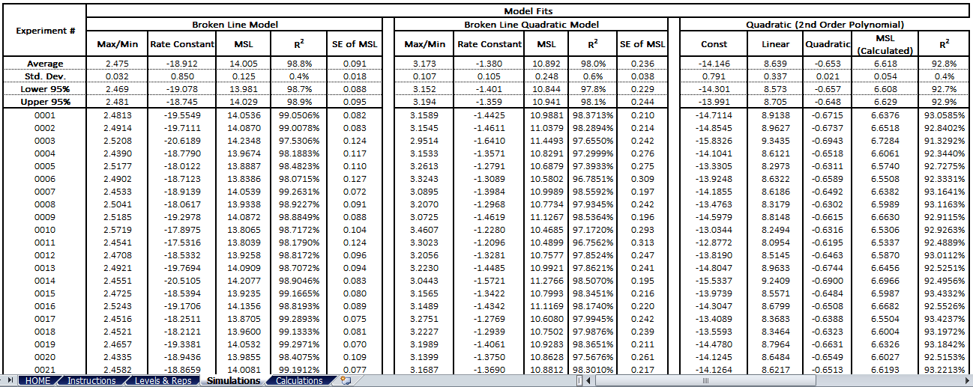
Step 5: Reading the results (Simulations Worksheet)
Max/Min = Maximum or Minimum biological response; MSL= Maximum Safe Level of the Ingredient; SE of MSL= Standard error of the mean MSL
The simulation results for the models selected in step 3
Each value is the average of the experiments
Step 1:
For the Broken Line Model under the current settings
The MSL= 14.005% ± 0.125 (SD) or 0.091 (SE)
The confidence interval for the mean MSL is 13.981-14.029
The coefficient of determination (R²) is 98.8%
Each line represents one experiment

Slide 8
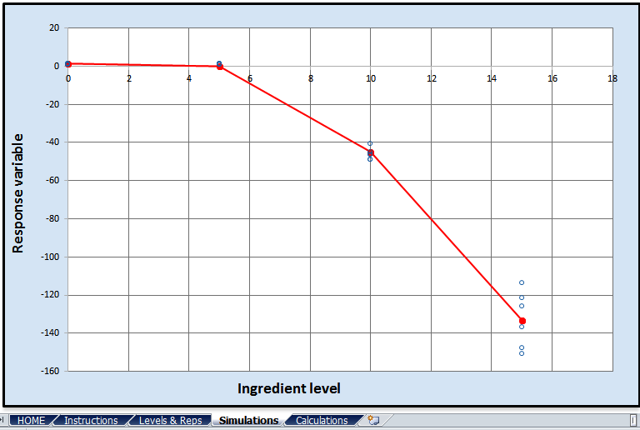
Step 5: Reading the results (Simulations Worksheet)
Step 1:

Slide 9
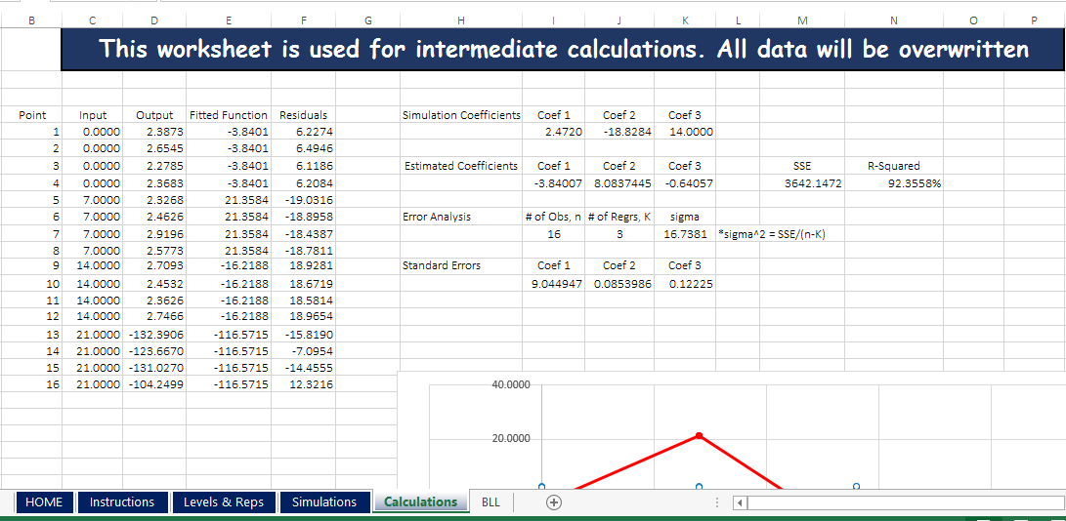
Step 6: View the Calculations Worksheet
The regression coefficients from step 2
Step 1:
Estimated regression coefficients for the current model
levels and replications combinations

